Slide 1
Correlation
Chapter 7

Slide 2
What is a Correlation?
It is a way of measuring the extent to which two variables are related.
It measures the pattern of responses across variables.

Slide 3
No relationship
Notes:
Appreciation of Norwegian Black metal Band Dimmu Borgin against age

Slide 4
Positive Relationship

Slide 5
Negative Relationship

Slide 6
Scatterplots + Matrices
Graph builder > scatter plot
one in X, one in Y
Graph builder > scatter matrix
All the variables in X axis
Exam Anxiety dataset (c7 exam.sav)

Slide 7
Scatterplots
Not only do you need to check X and Y for proper labels
Now you need to make sure X and Y are appropriate lengths for your scatterplot
Although this rule is less strictly enforced than the bar graph rule.

Slide 8
Modeling Relationships
First, look at some scatterplots of the variables that have been measured.
Outcome_{i} = (model ) + error_{i}
Outcome_{i} = (bX_{i} ) + error_{i}
b = beta = r when you have one predictor

Slide 9
Modeling Relationships
Outcome_{i} = (model ) + error_{i}
Previously, this was Mean + SE
And we used SE to determine if the model “fit” well.

Slide 10
Modeling Relationships
Outcome_{i} = (bX_{i} ) + error_{i}
Now we are using b or r or beta to determine the strength of the model
Traditionally you don’t see the error values reported (sometimes you see CI)

Slide 11
Measuring Relationships
We need to see whether as one variable increases, the other increases, decreases or stays the same.
This can be done by calculating the Covariance.
We look at how much each score deviates from the mean.
If both variables deviate from the mean by the same amount, they are likely to be related.

Slide 12
Revision of Variance
The variance tells us by how much scores deviate from the mean for a single variable.
It is closely linked to the sum of squares.
Covariance is similar – it tells is by how much scores on two variables differ from their respective means.

Slide 17
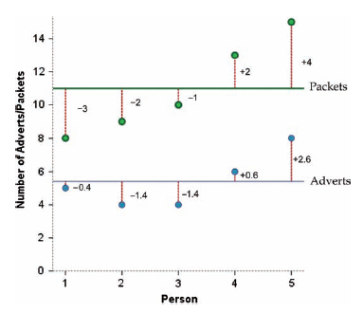

Slide 18
Packets
Adverts

Slide 19
Problems with Covariance
It depends upon the units of measurement.
One solution: standardize it!
Divide by the standard deviations of both variables.
The standardised version of Covariance is known as the Correlation coefficient.
It is relatively affected by units of measurement.

Slide 20
The Correlation Coefficient

Slide 21
The Correlation Coefficient

Slide 22
Correlation Coefficient
Basically, r values have the model + error built into one number
Instead of M + SE
So we can just look at r to determine “model fit” or strength of relationship.

Slide 23
Things to know about the Correlation
It varies between -1 and +1
0 = no relationship
It is an effect size
±.1 = small effect
±.3 = medium effect
±.5 = large effect
Coefficient of determination, r²
By squaring the value of r you get the proportion of variance in one variable shared by the other.

Slide 24
R versus r
R = correlation coefficient for 3+ variables
r = correlation coefficient for 2 variables
r² = coefficient of determination for 2 variables
R² = coefficient of determination for 3+ variables
In reality, we use R² for anything effect size related, even if it’s only 2

Slide 25
Correlation: Example
Anxiety and Exam Performance
Participants:
103 students
Measures
Time spent revising (hours)
Exam performance (%)
Exam Anxiety (the EAQ, score out of 100)
Gender

Slide 26
Conducting Correlation Analysis

Slide 27
Assumptions
All the assumptions!
(accuracy, missing)
SCREEN ALL THE THINGS! (outliers, normality, linearity, homogeneity, homoscedasticity)
Remember the rule
They made the number = screen it.

Slide 28
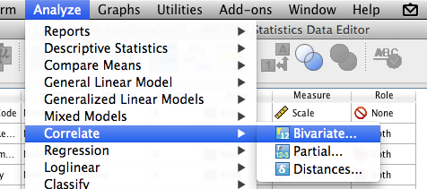
SPSS
Analyze > correlate > bivariate
Move them all over!

Slide 29
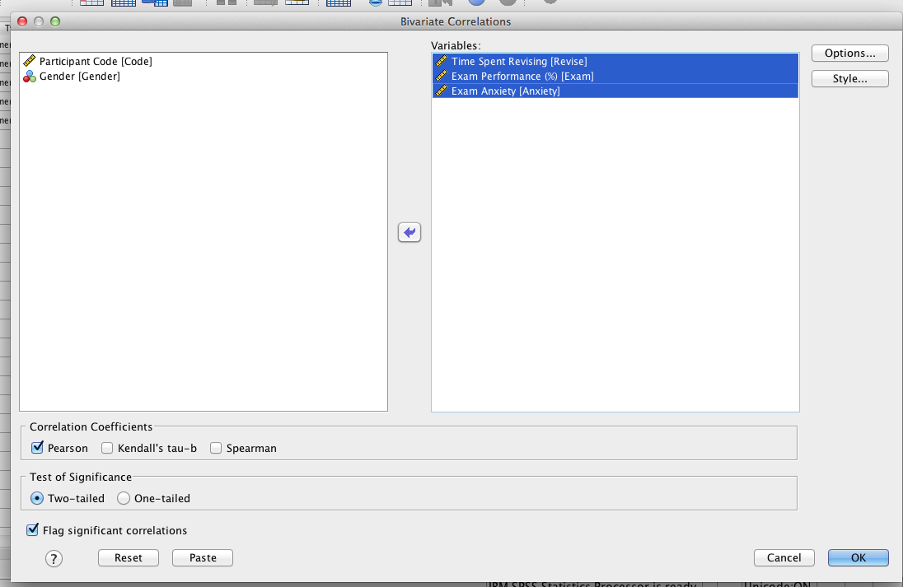
Correlation Output

Slide 30
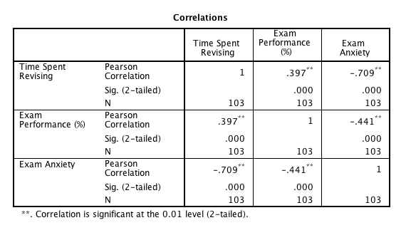
Output
Reporting = r = .40, p<.001

Slide 31
Significance Tests
Using Z
Fisher’s r to Z transform
Using t
(SPSS does this version)

Slide 32


Significance Tests
Fisher’s r to Z
z_{r}
SE =
Z = z_{r} / SE
Remember the cut off scores for p…
+/- 1.96, 2.58

Slide 33
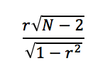
Significance Tests
t =
df = N - 2

Slide 34
Significance Tests
Why should I care?
Corrections for too many correlations (usually Bonferroni, so you can look directly at p)
Comparing correlations
Checking if someone is wrong
Comparing two correlation coefficients!

Slide 35
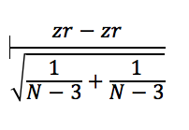
Compare Correlations
Comparing independent correlations
Formula =

Slide 36
Compare Correlations
Comparing dependent correlations
Formula = gross (it’s on page 287 if you want).

Slide 37

Confidence Intervals
z_{r} – (1.96 X SE) = lower
Z_{r} + (1.96 X SE) = upper
Or 2.58 for 99% confidence interval
Translate back to r

Slide 38
Correlation and Causality
The third-variable problem:
in any correlation, causality between two variables cannot be assumed because there may be other measured or unmeasured variables affecting the results.
Direction of causality:
Correlation coefficients say nothing about which variable causes the other to change

Slide 39
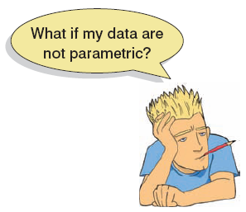
Nonparametric Correlation
Spearman’s Rho
Pearson’s correlation on the ranked data
Kendall’s Tau
Better than Spearman’s for small samples
When lots of things have the same rank

Slide 40
Example
World’s best Liar Competition
68 contestants
Measures
Where they were placed in the competition (first, second, third, etc.)
Creativity questionnaire (maximum score 60)
C7 liar.sav

Slide 41
SPSS
Analyze > correlate > bivariate
Move them all over!

Slide 42
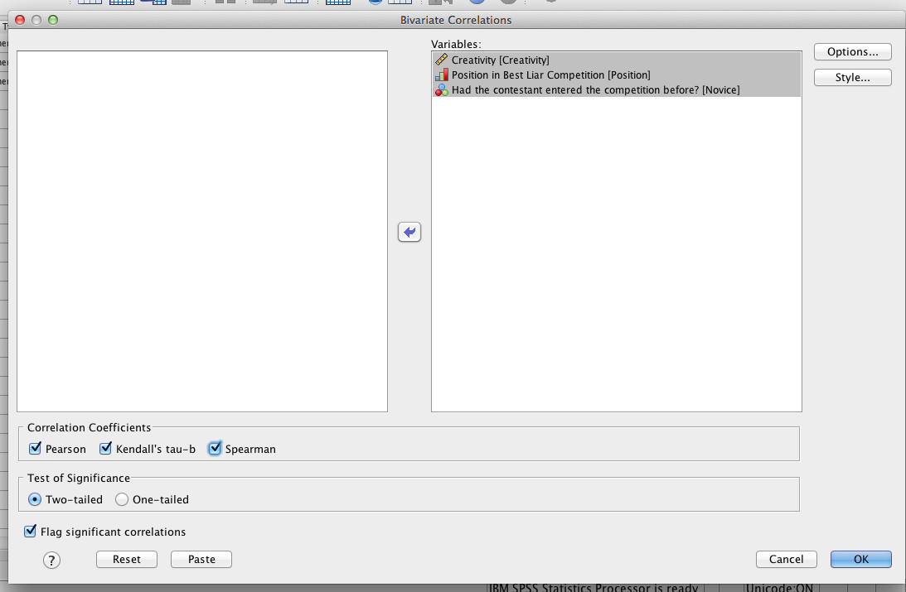
SPSS

Slide 43
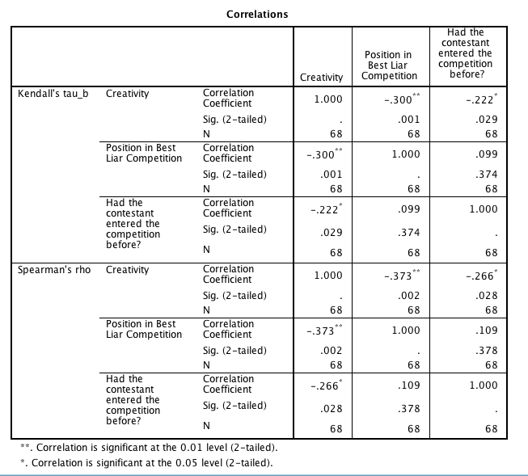
Output

Slide 44
Point vs not point
Point/Biserial correlation = correlation with a dichotomous variable
Which is which?
Point biserial = true dichotomy, no underlying continuum (i.e. gender)
Biserial = not quite discrete (i.e. pass/fail)
SPSS does PBS when you select dichotomous variables
(this means 2 levels, more = treats as real correlation)

Slide 45
Partial and Semi-Partial Correlations
Partial correlation:
Measures the relationship between two variables, controlling for the effect that a third variable has on them both.
Semi-partial correlation:
Measures the relationship between two variables controlling for the effect that a third variable has on only one of the others.

Slide 48
A word on PR/SR
Part = SR
Partial = PR
When?
Normally these are part of regression (especially hierarchical)

Slide 49
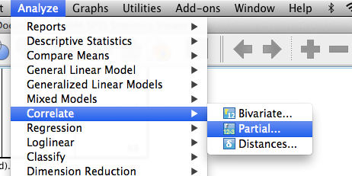
SPSS (partial)
Analyze > correlate > partial

Slide 50
SPSS (partial)
Put the two you want correlated in the top box.
Put the one you want to control for in the bottom box.

Slide 51
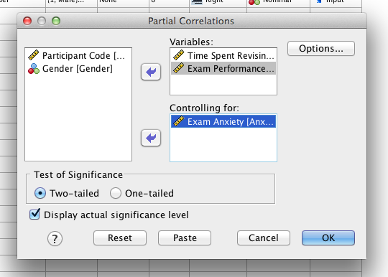

Slide 52
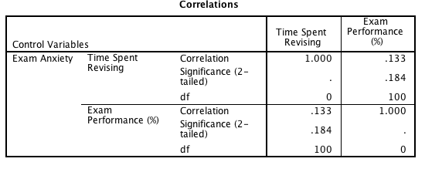
Output

